Slide 1
Automata Project Title: NON DETERMINISTIC PDA CORRESPONDING TO CFG CONVERSION FORM OF CFG
Group MEMBERS
11508 Muzammil khan
11304 Furqan Zahid SIR NADEEM QAMAR

Slide 2
Non Deterministic Pushdown Automata A non-deterministic PDA is used to generate a language that a deterministic automata cannot generate. It is more powerful than a deterministic PDA. So, a push down automata is allowed to be non-deterministic q₀ is the initial state. Z₀ is the initial stack symbol. F is the set of accepting states. ∑ is the finite set of input alphabet.

Slide 3
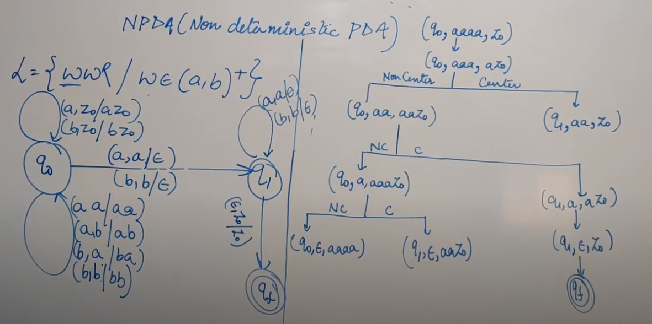

Slide 4
PDA CORRESPONDING TO CFG

Slide 5
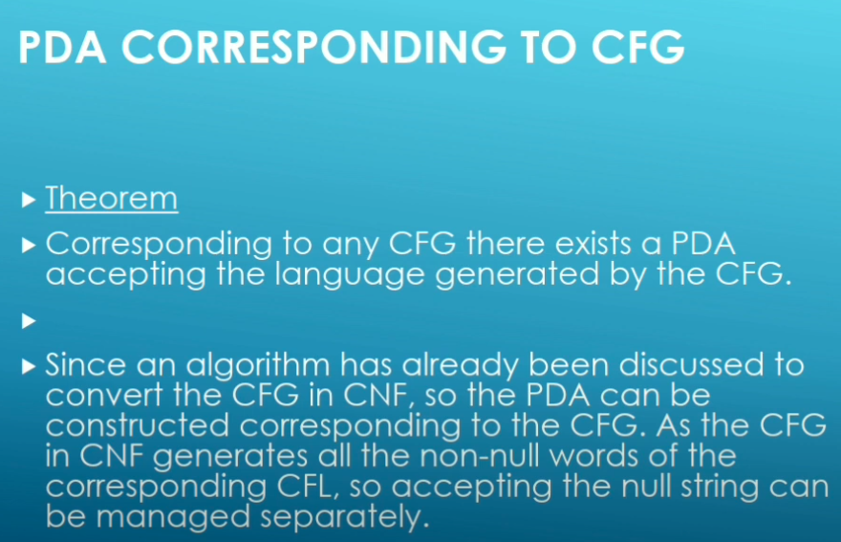

Slide 6
CONVERSION FORM OF PDA

Slide 7
Definition: A PDA is in conversion form if it fulfills the following conditions: 1. There is only one ACCEPT state. 2. There are no REJECT states. 3. Every READ or HERE is followed immediately by a POP 4. No two POPS exist in a row on the same path without a read

Slide 8
THANK YOU

